Slide 1

Choosing the Right Statistical Test
A Framework for Making Informed Decisions
Presenter: Nasim Reza
June 22, 2025

Slide 2
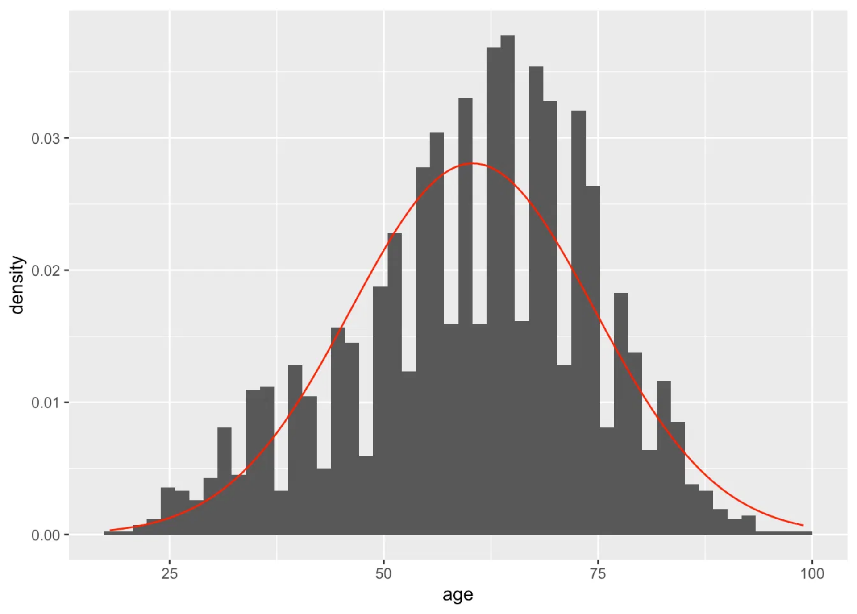
Key Questions Before Choosing a Test
What is your research question?
Is there a difference? Is there a relationship? Is there an effect over time?
What type of data do you have?
Nominal, Ordinal, Interval, Ratio
How many groups/variables are you comparing?
Two, three+, paired, independent
Are your data normally distributed?
Parametric vs. Non-parametric
Are your observations independent?
Independent vs. Dependent samples

Slide 3
Types of Data
Nominal Data
Categorical data with no inherent order or ranking.
Eye Color
Examples: Gender, Blood type, Ethnicity, Colors, Yes/No responses
Country of Origin
Nominal
Ordinal Data
Yes/No
Categorical Data
Categorical data with a clear order or ranking, but intervals between values may not be equal.
Satisfaction Ratings
Examples: Education level, Satisfaction ratings, Likert scales (1-5), Medal rankings (Gold, Silver, Bronze)
Ordinal
Letter Grades
Data
Interval Data
Number of Students
Interval
Numerical data with equal intervals between values, but no true zero point.
Number of Cars
Examples: Temperature in Celsius/Fahrenheit, IQ scores, pH scale
Numerical Data
Height
Ratio Data
Weight
Ratio
Numerical data with equal intervals and a true zero point, allowing for meaningful ratios.
Distance
Examples: Height, Weight, Age, Income, Distance, Temperature in Kelvin
Time

Slide 4
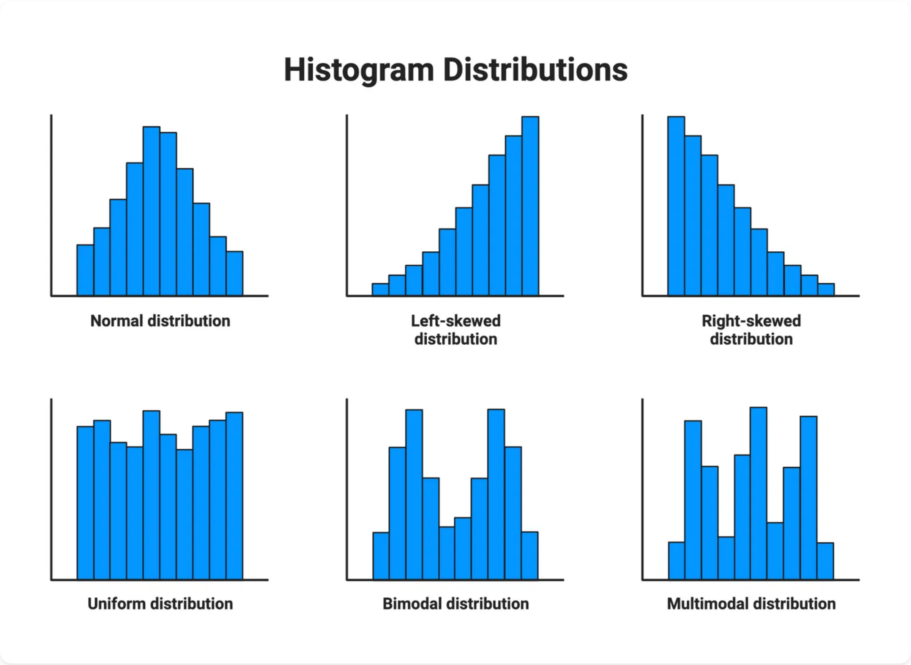



What is Distribution?
A
distribution
is the pattern of variation in a dataset,
showing how frequently different values occur and how
they are spread out. It helps us understand the central
tendency, variability, and shape of our data.
Normal Distribution
Symmetrical, bell-shaped curve with most values clustering around the mean. Example: Heights in a population.
Skewed Distribution
Asymmetrical with a longer tail on one side. Can be right-skewed or left-skewed Example: Income distribution.
Bimodal Distribution
Has two peaks, indicating two different clusters or subgroups in the data. Example: Exam scores from two different classes.
The shape of your data's distribution helps determine which statistical tests are appropriate to use. Parametric tests typically assume a normal distribution.

Slide 5
Dependent vs Independent Observations
Independent Observations
Statistical Tests Based on Observation Type
Observations or measurements that do not influence each other. Each data point is completely separate from other data points.
Independent Observations
Dependent Observations
Scenario
Examples:
Random samples from different populations
Two groups
Independent t-test
Paired t-test
Different participants in control vs. treatment groups
Two groups (non-parametric)
Wilcoxon signed-rank test
Mann-Whitney U test
Dependent Observations
Three+ groups
One-way ANOVA
Repeated Measures ANOVA
Observations or measurements that are related to or influenced by each other. Data points have a natural pairing or connection.
Three+ groups (non-parametric)
Kruskal-Wallis H test
Friedman test
Examples:
Pre-test and post-test measurements on the same subjects
Chi-square test / Fisher's exact test
Categorical Data
McNemar's test
Repeated measurements over time on the same subjects

Slide 6
Statistical Test Selection Flowchart
Compare Groups Assess Relationships, or Analyze Frequencies?
Compare Groups
(Numerical Data)
Assess Relationships
(Numerical Data)
Analyze Frequencies
(Categorical Data)
How many groups/measurements?
Use Correlation
Independent or
Dependent(Paired) Groups?
Two
>Two
Independent
Dependent
Independent or Dependent(Paired) Groups?
Independent or
Dependent (Repeated)
Groups?
Use Chi-Square, Fisher's Exact
Independent
Dependent
Independent
Dependent
Use Independent t-Test (or Welch's t-test)
Use Paired t-Test
Use One- Way ANOVA
Use Repeated Measures ANOVA

Slide 7
Statistical Test Selection Flowchart
Compare Groups Assess Relationships, or Analyze Frequencies?
Compare Groups
(Numerical Data)
Assess Relationships
(Numerical Data)
Analyze Frequencies
(Categorical Data)
Two Groups
More then Two Groups

Slide 8

Comparing Two Independent Groups
Research Question: Is there a significant difference between two unrelated groups?
Parametric Option: Student's t-test
Non-parametric: Mann-Whitney U test
Assumptions:
When to Use:
Interval/Ratio data
When assumptions for t-test are violated (especially normality/homogeneity).
Independence of observations
Normality
Homogeneity of variances
Assumptions:
Ordinal/Interval/Ratio data
When to Use:
Independence of observations
Comparing means of two independent groups.

Slide 9
Comparing Two Dependent (Paired) Groups
Research Question: Is there a significant difference between two related measurements?
Parametric Option: Paired t-test
Non-parametric Alternative: Wilcoxon signed-rank test
Assumptions:
Interval/Ratio data
When to Use:
Independence of pairs
When assumptions for paired t-test are violated (especially normality of differences).
Normality of the differences between pairs
When to Use:
Assumptions:
Comparing means of two paired samples.
Ordinal/Interval/Ratio data
Independence of pairs
Examples: Pre/post measurements, matched pairs, repeated measures on same subjects

Slide 10
Comparing Three or More Independent Groups
Research Question: Is there a significant difference among three or more unrelated groups?
Parametric Option: One-way ANOVA
Non-parametric Alternative: Kruskal-Wallis H test
Assumptions:
Interval/Ratio data
When to Use:
Independence of observations
When assumptions for ANOVA are violated (especially normality/homogeneity).
Normality within groups
Homogeneity of variances
Assumptions:
When to Use:
Ordinal/Interval/Ratio data
Comparing means of three or more independent groups.
Independence of observations
Note: If ANOVA shows significance, post-hoc tests (e.g., Tukey's HSD) are needed to determine which specific groups differ.

Slide 11

Comparing Three or More Dependent Groups
Research Question: Is there a significant difference across three or more related measurements?
Parametric Option: Repeated Measures ANOVA
Non-parametric Alternative: Friedman test
Assumptions:
When to Use:
Interval/Ratio data
When assumptions for Repeated Measures ANOVA are violated.
Independence of subjects
Assumptions:
Normality of differences
Sphericity
Ordinal/Interval/Ratio data
Independence of subjects
When to Use:
Comparing means across three or more related samples.

Slide 12

Analyzing Categorical Data
Research Question: Are observed frequencies/proportions different from expected, or is there an association between categorical variables?
For Independent Categorical Data
For Dependent Categorical Data
Chi-square test
McNemar's test
Assumptions:
Assumptions:
Independent observations
Paired nominal data
Expected cell counts > 5 (or a reasonable proportion)
When to Use:
When to Use:
Comparing proportions in paired samples (e.g., before/after intervention on a binary outcome).
Testing association between two categorical variables, or goodness-of-fit for one categorical variable.
Fisher's exact test
Assumptions:
Independent observations
When to Use:
Preferred over Chi-square when expected cell counts are very low (especially in 2x2 tables).

Slide 13


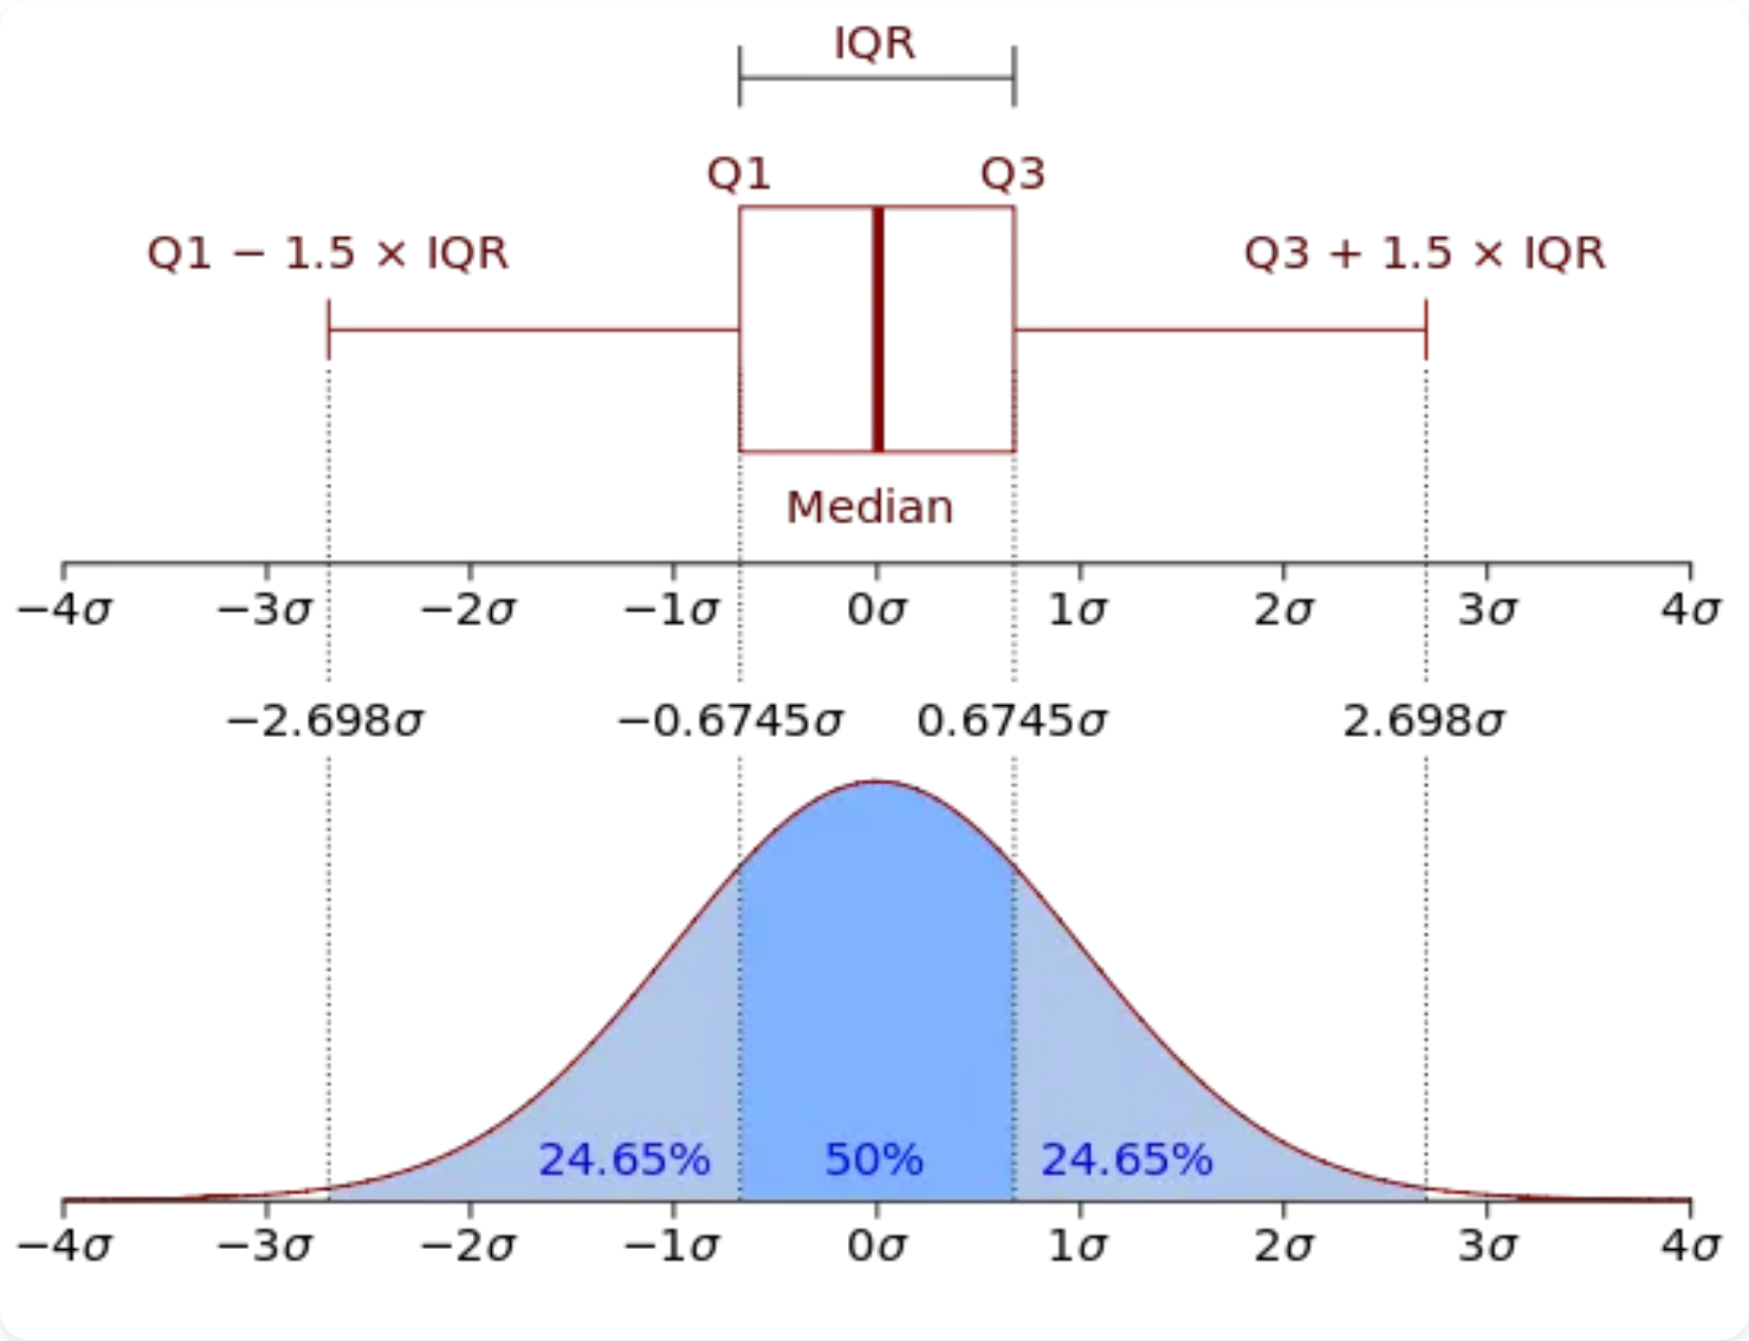


Before You Run the Test: Data Exploration is Key!
Proper exploration helps ensure your test selection is appropriate
Visualizing Data
Use histograms, box plots, and scatter plots to understand your data's distribution and relationships.
Checking for Outliers
Identify and decide how to handle extreme values that may influence your results.
Assessing Normality
Use Q-Q plots and Shapiro-Wilk test to check if your data follows a normal distribution.
Assessing Homogeneity of Variances
Use Levene's test to check if different groups have similar variances.
Visual inspection is often more informative than relying solely on statistical tests for assumptions!

Slide 14

A Checklist for Test Selection
Question
Your Response
Research Question:
What are you trying to find out?
Number of Variables/Groups:
How many are involved?
Variable Type(s):
Nominal, Ordinal, Interval, Ratio?
Independence of Observations:
Paired or Independent?
Distribution:
Normal or non-normal?
Assumptions Met?
Yes/No
Chosen Test:
Based on above criteria
Alternative Test (if needed):
If assumptions not met
This checklist can be used as a printable handout for future reference.

Slide 15

Thank You!
For taking the time to learn about selecting the right statistical test for your research needs.
Any Questions?

